Slide 1
Epidemic Simulation
Gabriel Pitzel - Oliver Jeremiah Fernandez - Bryan Lin

Slide 2
What We Have Accomplished - Preview
Extremely configurable model
Detailed in simulation
Thorough in analysis
In depth world parameters
Built off recent real world events

Slide 3
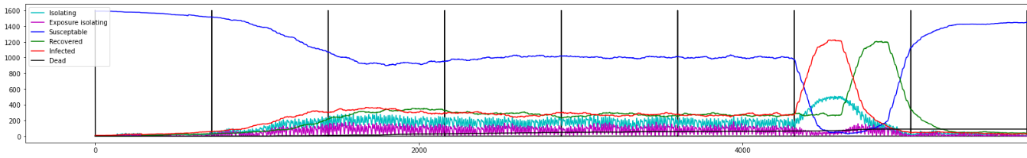
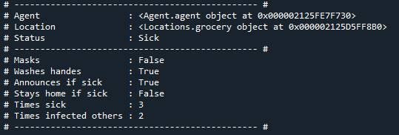
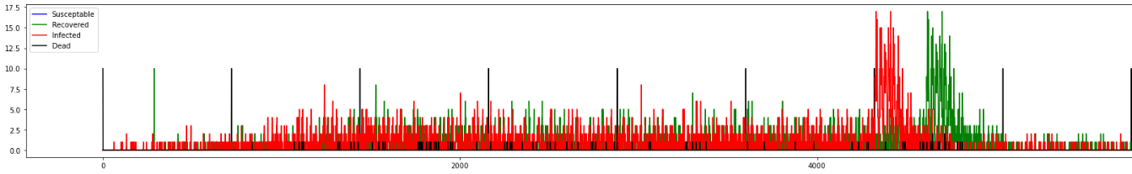
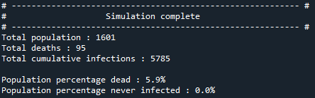

Model Overview
Agent based epidemic simulation designed for trend analysis on current or theoretical diseases
A model configured to replicate Covid-19 with the Omicron surge and vaccine included

Slide 4
How it works
Agents:
Move between locations on a schedule Each hour infected agents attempt to infect others Infection chance is determined by many factors If sick, sickness progresses with time
Special cases exist and are handled:
Immune compromised
Asymptomatic
Simulation:
Runs agent updates
Handles world events and parameters
Simulated strains
Simulates government response

Slide 5
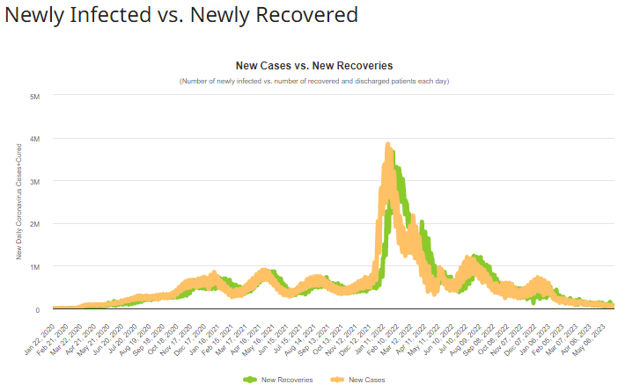
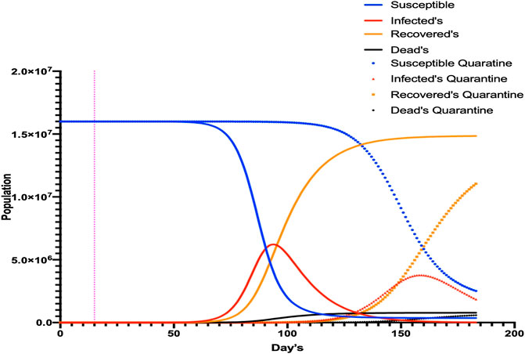
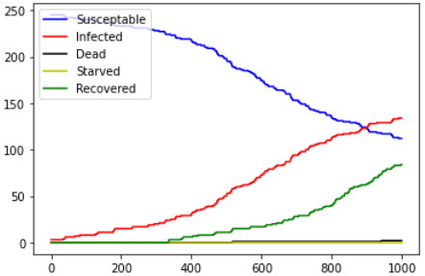
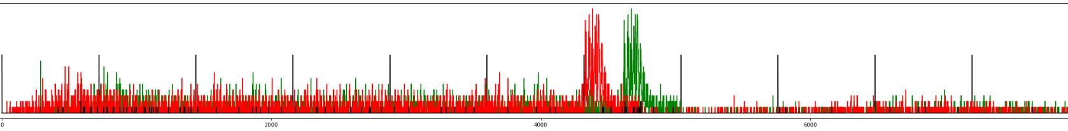
Validation and Verification
Logical analysis : Trends match real-world epidemic trends
Overinfection : Too infectious diseases die out, see Covid-19 Omicron
Infection waves : Infection acts in waves
Population density : Rate of spread influenced by population density
Common trend in SIR+ models
Covid-19 + Omicron Surge

Slide 6
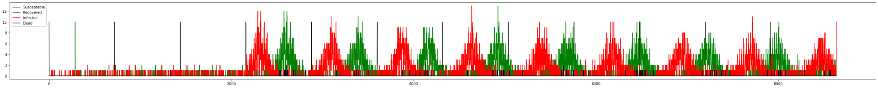
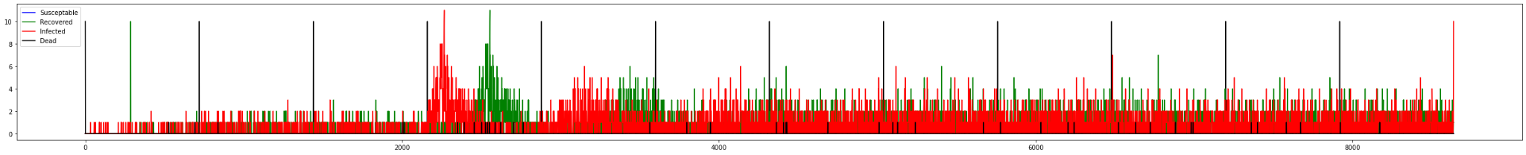
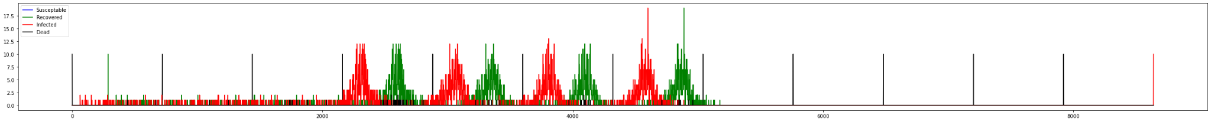
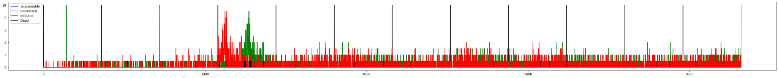
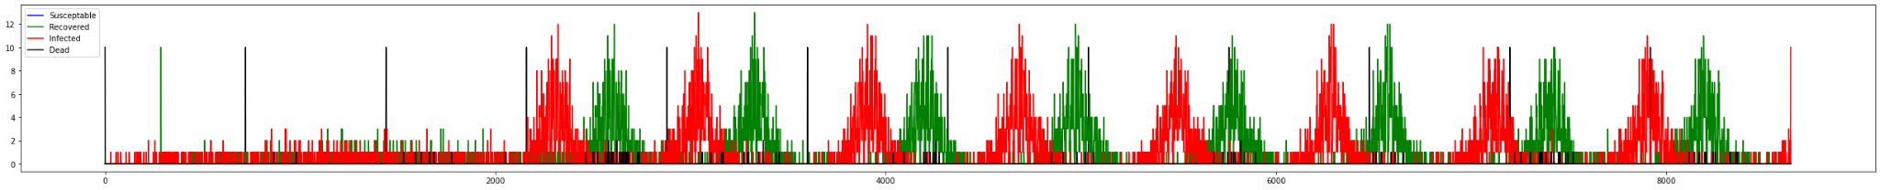

Analysis
Mask
Response:
8.42% Dead
Response Analysis: (Triggered at 40% global infection) (10 runs per response setup averaged) Response types:
Mandate isolation Mandate vaccine Mandate masks
What does this tell us?
Vaccine
Response:
4.22% Dead
Isolation
Response:
5.82% Dead
Full response:
3.5% Dead
No response:
11.1% Dead

Slide 7
What we have discovered - Review
Validation and verification is one of the most difficult aspects of model building
Translating real world data into simulated parameters isn't 1:1
Optimization is important
Non-performant code heavily slows down development

Slide 8
Q/A
Questions?
Please ask about anything!

